Slide 1
Network Monitoring @Massive Scale
Richard Sheehan
Production Engineer

Slide 2
Basics of fault detection
How people fix broken networks

Slide 3
Data-center Network
Spine switches
Multi-stage Clos Topologies
Lots of devices and links
BGP Only
IPv6 >> IPv4
Large ECMP fan-out
L2 and L3 ECMP
Cluster switches
Rack switches
Notes:
it is a multi-stage Clos topology, running 100% on BGP. Some specifics – ECMP everywhere, IPv6 first and large amount of symmetry. This symmetry makes debugging the data-center network more challenging.

Slide 4
Backbone Network
Data-Center
DR
DR
MPLS core
BB = Backbone Router (LSR)
Data-center attachment
DR = Datacenter Router (LER)
Auto-bandwidth
ECMP over MPLS tunnels
BB
BB
MPLS Core
MPLS LSP
BB
BB
DR
Data-Center
DR
Notes:
Backbone network has less devices but more protocols than data-center. It consists of an MPLS core that use MPLS-TE, and data-center routers that attach our data-centers. the data-center routers is the IP2MPLS edge in teh backbone. The two major challenges for fault isolation here is auto-bandwidth, since it causes major LSP churn, and use of ECMP over MPLS tunnels.

Slide 5
No Network Monitoring
People tell you when the network is broken
People tell you when they *think* the network is broken
You investigate EVERYTHING, all the time

Slide 6
How a Human Debugs it
Ping/hping/nping (TCP/ICMP/UDP probing)
Change src port to try all ECMP paths
Find a broken path, then run traceroute over it
Notes:
How does a human debug unknown problem? Just like 20-30 years ago, starting with the use of different ping utilities. Iterating over source ports could be used to try different ECMP paths in the network. Once we detect a broken path, we run traceroute with the known source and dest address and port combination to see where the fault occurs in the path. To sum it up – ping and traceroute are still the king of network investigations

Slide 7
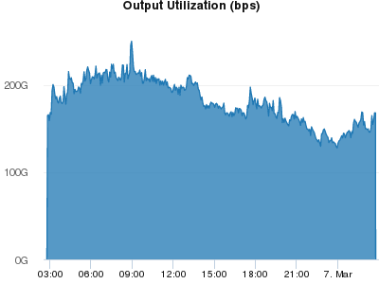
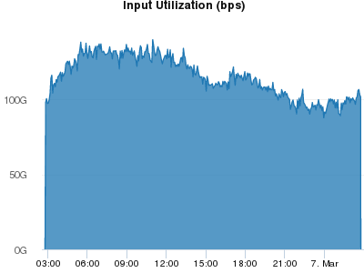
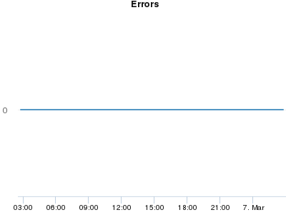
Build Some Graphs

Slide 8
Detecting Packet Loss
Standard counters
Non-Standard counters
fsw001.p001.f01.atn1# show platform trident counters
Debug counters
Description
T2Fabric19/0/1 RX - Non congestion discards
T2Fabric19/0/1 TX - IPV4 L3 unicast aged and dropped pkts
T2Fabric19/0/1 RX - Receive policy discard
T2Fabric19/0/1 TX - L2 multicast drop
T2Fabric19/0/1 RX - Tunnel error packets
T2Fabric19/0/1 TX - Invalid VLAN
T2Fabric19/0/1 RX - Receive VLAN drop
T2Fabric19/0/1 RX - Receive multicast drop
T2Fabric19/0/1 TX - Dropped because TTL counter
T2Fabric19/0/1 RX - Receive uRPF drop
T2Fabric19/0/1 TX - Packet dropped due to any condition
T2Fabric19/0/1 RX - IBP discard and CPB full
T2Fabric19/0/1 TX - Miss in VXLT table counter
Too slow…
Unreliable…
Notes:
How do we commonly detect a problem in a network? Clearly, via the numerous counters we pull from our devices. Likely over SNMP or CLI scraping. If the counters show an issue, they are most often being accurate. However, if they don’t show anything bad, you may still have a problem. You just don’t know about it.

Slide 9
NetNORAD
The network fault detector
Notes:
let’s see how human debugging logic could be applied to a larger scale. In this section we will take a look at NetNORAD – our universal fault detector.

Slide 10
Massive Pinging
Pingers
Run “pingers” on some machines
Run responders on lots of machines
Targets count ~= 100x pingers count
Collect packet loss and RTT…
Analyze and report!
Network
Responders
Notes:
The underlying idea is very simple. We designate some of Facebook’s machines as “pingers” and make them probe lots of other machines, called targets. The traffic will cross both data-center and backbone networks. We then take the loss report data from pingers and try to find out what’s broken. Notice that we have much less pingers as compared to targets. This is important to scale the volume of data.

Slide 11
NetNORAD evolution
1st Run`ping` from python agent
2nd Raw sockets, fast TCP probes
3rd Raw sockets, fast ICMP probes
Now: UDP probing + responder agent
Notes:
Quick history tour. We started around 2013 with python scripts running the ping command. Next, we moved to a faster packet prober that was injecting and receiving TCP probes using raw sockets. Once we get people complaining of TCP resets, we moved to fast ICMP probing in 2014. Both TCP and ICMP actually worked great, since kernel was the responder. Last year, we migrated to a system with custom application responder using UDP probing. If it helps, a close analogy could be iperf.

Slide 12
Pinger and Responders
Pingers | Responders
Send UDP probes to target list
Timestamp & Log results
High ping-rate (up to 1Mpps)
Set DSCP marking
Receive/Reply to UDP probe
Timestamp
Low load: thousands of pps
Reflect DSCP value back
Open sourced (C++), https://github.com/facebook/UdpPinger
Notes:
Two central components of the system are pinger and responder processes. This table compares those two. The pinger’s main goal is to send and receive packets very quickly. All it does is probes all of its targets periodically, using multiple different DSCP values. The responder is a simple process that receives, timestamps and echoes a probe back. It does honor the original DSCP marking when sending the replies. And last but not least – we open-sourced the pinger and the responder code.

Slide 13
Why UDP probing?
Probe Format
No TCP RST packets
Efficient ECMP
Extensible
Signature
SentTime
RcvdTime
ResponseTime
Traffic Class
Notes:
Why not TCP? Just like TCP, the UDP packets explore multiple ECMP paths as they travel. The UDP packets are generally well handled by Receive Side Scaling in the hosts. But the major one, is flexibility. We can embed additional data in those packets, such as time-stamping and signature. There are more use cases for UDP we have in mind in the future.

Slide 14
NetNORAD
How to ping and process data?
Notes:
We went over the systems building blocks. Next topic is organizing the pings and processing the data.

Slide 15
CCChallenges
Tens of thousands of targets
Hundreds of pingers
Lots of data to process
We really do not care about each host…
…The unit of interest is “cluster” health
Notes:
The main challenge is the volume of data. We need to find a good way to aggregate and extract relevant signals. The key insight is that we do not care of every single host, or even rack. In most cases, the units are interested in are “clusters” or “pods” that group hundreds of racks together.

Slide 16
The Network Hierarchy
POP 2
POP 1
Cluster 1
Cluster 1
Backbone
Rack 1
Rack 2
Rack 1
Rack 2
Region 1
Region 2
DC 1
DC 2
DC 1
DC 2
Cluster 1
Cluster 2
Cluster 1
Cluster 2
Rack 1
Rack 2
Rack 1
Rack 2
Notes:
To understand the following sldies better, take a look at Facebook’s network hierarchy. We see the backbone network that connects together multiple regions. A region for us is a collection of data-center buildings. For example, in Prineville, OR. Each data-center houses multiple clusters, in turns consisting of racks.

Slide 17
Pinging inside clusters
CSW 4
Detect issues with rack switches
Dedicated pingers per cluster
Probe ALL machines in cluster
Store time-series per host/rack
Lags real-time by ~2-3 minutes
CSW 3
CSW 2
CSW 1
RSW 1
RSW 2
RSW 3
target
target
pinger
target
target
pinger
CSW – cluster switch
RSW – rack switch
Notes:
We still collect packet-loss time-series for hosts and racks, but we do actively alarm on those. We do keep them for historical or no-real time investigations. The data may lag real time by a few minutes.

Slide 18
Pinging the Clusters
Pinger 2
Cluster
Data-Center
Pinger 3
Cluster
Region
WAN
Data-Center
Region
Data-Center
Target Cluster
Cluster
Pinger 1: Same DC
Pinger 2: Same Region
Pinger 3: Outside of region
Pinger 1
Notes:
Our main goal is detecting if the cluster switches may have an issue causing packet loss. We aggregate the loss statistics for all machines in the cluster, and split it in three different streams. First one is based on results from pingers in the cluster’s data-center. Second one, is based on results from pingers in the same region. And the last is based on the pingers outside of our region.

Slide 19
Processing the Data
Notes:
Moving on to data processing in NetNORAD pipeline.

Slide 20
Alarming on Packet Loss
Alarm
Build packet-loss time-series
Track percentiles
Time to detect loss: 20 seconds
90th pctile
Clear Alarm
Cluster X DC data
Notes:
Tailers/processors buil s time-series of packet loss for each cluster and ping source. For each time-series we track 90th percentile to weed out outliers. We define different raising and falling threshold depending on target type. For example, the clusters in POPs typically have higher thresholds, as they are smaller and thus more noisy. With this design, our average time to detect a significant failure is about 10-20 seconds – way faster than an SNMP counter polling would have told us.

Slide 21
Isolating Network Faults
Detecting is not everything
Notes:
On to our next topic, the fault isolation.

Slide 22
Root Cause Isolation
Likely problem with spine switches
Pinger 2
Cluster
Data-Center
Issue
Pinger 3
Cluster
Data-Center
Region
WAN
Data-Center
Cluster X
Cluster
Region
Data-Center
Cluster X
Cluster
Pinger 1: no loss to X!
Pinger 2: I see loss!
Pinger 3: I see loss too!
Pinger 1
Cluster
Notes:
Lets iterate on some natural fault isolation that comes from probing hierarchy. Firstly, if you see packet loss reported for a cluster from pingers in the same data-center, same region and outside of the region, you can be sure the problem is localized in the data-center. This allows for cutting on redundant alarms immediately.

Slide 23
Next Steps to Isolate
Approximate location
Still lots of devices/links
Check device counters
if that does not help…
Remember traceroute?
Loss
Custer 1
Custer 2
Custer 3
Notes:
once we know the approximate location of the failure what do we do? Depending on the location, this could be from four to 128 devices. Usually we first check the SNMP counters and alarms for the affected area, and if it does not work, we resort to our favorite traceroute command.

Slide 24
Fbtracert: fast and wide traceroute
4
Src ports 32701 32703 TTL 2-6
Src ports 32701 32703 TTL 5-6
Src ports 32701 TTL 3-6
Src ports 32701 TTL 4-5
Src ports 37701
32702
32703
32704
TTL 1-6
Src Ports 37701
32702
32703
32704 TTL 6
2
8
Src ports 32703
TTL 3-6
Src ports 32703 TTL 4-5
Loss
5
Source
1
10
Target
6
Src ports 32702 TTL 3-6
Src ports 32702 TTL 4-5
3
9
Src ports 32702 32704 TTL 2-6
Src ports 32704
TTL 3-6
Src ports 32704 TTL 4-5
Src ports 32702 32704 TTL 5-6
7
Notes:
Fbtracert explores multiple paths in the network in parallel by shooting out TCP probe packets with varying source port and TTL values

Slide 25
Fbtracert Limitations
CoPP drops ICMP responses
Paths may flap (MPLS LSP)
ICMP gets tunneled with MPLS TE
ICMP responses from wrong interfaces
Open sourced (Golang), https://github.com/facebook/fbtracert
Notes:
Of course not everything is so great with the traceroute approach. Firstly it does not work well over the backbone network where LSP paths often change. Next, the control plane policing would limit the rate of responses you get, and affect the time to detect a failure. Lastly, some network stacks are broken and send ICMP responses from unexpected interfaces.

Slide 26
Evolving Fault Detection & Isolation
Near and far future
Notes:
Few words on the future directions we envision for fault detection and isolation.

Slide 27
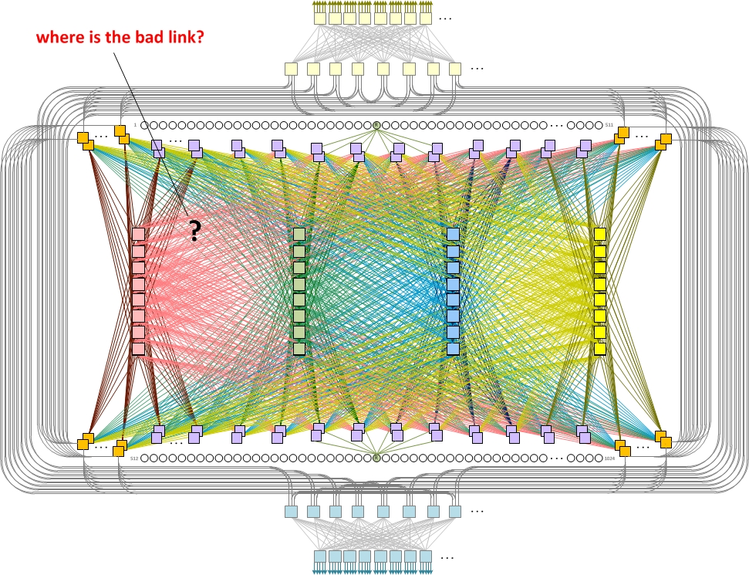
Big Fat Fabrics
Over 1,000 L3 Links between devices in different DCs in the SAME Region
We know there is loss between hosts, but where?

Slide 28
DC Network Fault Isolation
idc01.
dc1
ssw01.
dc1
idc02.
dc1
ssw01.
dc2
sw01.
dc1
ssw02.
dc1
idc03.
dc1
ssw02.
dc2
sw01.
dc2
sw02.
dc1
ssw03.
dc1
idc04.
dc1
ssw03.
dc2
sw02.
dc2
host1.dc1
rsw26.dc1
rsw45.dc2
Host.dc2
sw03.
dc1
ssw04.
dc1
idc05.
dc1
ssw04.
dc2
sw03.
dc2
sw04.
dc1
ssw05.
dc1
idc06.
dc1
ssw05.
dc2
sw04.
dc2
ssw06.
dc1
idc07.
dc1
ssw06.
dc2
DC1
idc08.
dc1
DC2

Slide 29
Bad Fabric Card
idc01.
dc1
ssw01.
dc1
idc02.
dc1
ssw01.
dc2
sw01.
dc1
ssw02.
dc1
idc03.
dc1
ssw02.
dc2
sw01.
dc2
sw02.
dc1
ssw03.
dc1
idc04.
dc1
ssw03.
dc2
sw02.
dc2
host1.dc1
rsw26.dc1
rsw45.dc2
Host.dc2
sw03.
dc1
ssw04.
dc1
idc05.
dc1
ssw04.
dc2
sw03.
dc2
sw04.
dc1
ssw05.
dc1
idc06.
dc1
ssw05.
dc2
sw04.
dc2
ssw06.
dc1
idc07.
dc1
ssw06.
dc2
DC1
idc08.
dc1
DC2

Slide 30
Bad Link
idc01.
dc1
ssw01.
dc1
idc02.
dc1
ssw01.
dc2
sw01.
dc1
ssw02.
dc1
idc03.
dc1
ssw02.
dc2
sw01.
dc2
sw02.
dc1
ssw03.
dc1
idc04.
dc1
ssw03.
dc2
sw02.
dc2
host1.dc1
rsw26.dc1
rsw45.dc2
Host.dc2
sw03.
dc1
ssw04.
dc1
idc05.
dc1
ssw04.
dc2
sw03.
dc2
sw04.
dc1
ssw05.
dc1
idc06.
dc1
ssw05.
dc2
sw04.
dc2
ssw06.
dc1
idc07.
dc1
ssw06.
dc2
DC1
idc08.
dc1
DC2

Slide 31
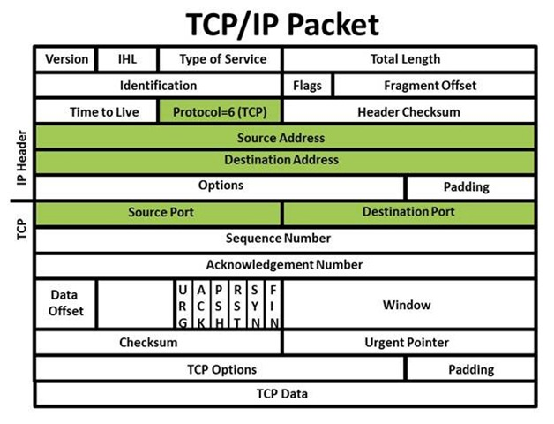
ECMP Packet Hashing

Slide 32
DC Network Fault Isolation
Port Range | 50,000 - 54,000
Request Rate | Approx 20,000 min
idc01.
dc1
ssw01.
dc1
idc02.
dc1
ssw01.
dc2
sw01.
dc1
ssw02.
dc1
idc03.
dc1
ssw02.
dc2
sw01.
dc2
sw02.
dc1
ssw03.
dc1
idc04.
dc1
ssw03.
dc2
sw02.
dc2
host1.dc1
rsw26.dc1
rsw45.dc2
Host.dc2
sw03.
dc1
ssw04.
dc1
idc05.
dc1
ssw04.
dc2
sw03.
dc2
FBTraceRT +
Lots of Thrift Requests
FBTraceRT +
Lots of Thrift Requests
sw04.
dc1
ssw05.
dc1
idc06.
dc1
ssw05.
dc2
sw04.
dc2
ssw06.
dc1
idc07.
dc1
ssw06.
dc2
DC1
idc08.
dc1
DC2

Slide 33
Map The Loss for Each Request
idc01.
dc1
ssw01.
dc1
idc02.
dc1
ssw01.
dc2
sw01.
dc1
ssw02.
dc1
idc03.
dc1
ssw02.
dc2
sw01.
dc2
sw02.
dc1
ssw03.
dc1
idc04.
dc1
ssw03.
dc2
sw02.
dc2
host1.dc1
rsw26.dc1
rsw45.dc2
Host.dc2
sw03.
dc1
ssw04.
dc1
idc05.
dc1
ssw04.
dc2
sw03.
dc2
sw04.
dc1
ssw05.
dc1
idc06.
dc1
ssw05.
dc2
sw04.
dc2
ssw06.
dc1
idc07.
dc1
ssw06.
dc2
DC1
idc08.
dc1
DC2

Slide 34
Map The Loss for Each Request
idc01.
dc1
ssw01.
dc1
idc02.
dc1
ssw01.
dc2
sw01.
dc1
ssw02.
dc1
idc03.
dc1
ssw02.
dc2
sw01.
dc2
sw02.
dc1
ssw03.
dc1
idc04.
dc1
ssw03.
dc2
sw02.
dc2
host1.dc1
rsw26.dc1
rsw45.dc2
Host.dc2
sw03.
dc1
ssw04.
dc1
idc05.
dc1
ssw04.
dc2
sw03.
dc2
sw04.
dc1
ssw05.
dc1
idc06.
dc1
ssw05.
dc2
sw04.
dc2
ssw06.
dc1
idc07.
dc1
ssw06.
dc2
DC1
idc08.
dc1
DC2

Slide 35
Overlay the Loss on Network Map
idc01.
dc1
ssw01.
dc1
idc02.
dc1
ssw01.
dc2
sw01.
dc1
ssw02.
dc1
idc03.
dc1
ssw02.
dc2
sw01.
dc2
sw02.
dc1
ssw03.
dc1
idc04.
dc1
ssw03.
dc2
sw02.
dc2
host1.dc1
rsw26.dc1
rsw45.dc2
Host.dc2
sw03.
dc1
ssw04.
dc1
idc05.
dc1
ssw04.
dc2
sw03.
dc2
sw04.
dc1
ssw05.
dc1
idc06.
dc1
ssw05.
dc2
sw04.
dc2
ssw06.
dc1
idc07.
dc1
ssw06.
dc2
DC1
idc08.
dc1
DC2

Slide 36
Analyze the Loss

Slide 37
Network Symmetry
48
idc01.
dc1
48
24
ssw01.
dc1
idc02.
dc1
ssw01.
dc2
24
sw01.
dc1
ssw02.
dc1
idc03.
dc1
ssw02.
dc2
sw01.
dc2
4
4
sw02.
dc1
ssw03.
dc1
idc04.
dc1
ssw03.
dc2
sw02.
dc2
host1.dc1
rsw26.dc1
rsw45.dc2
Host.dc2
sw03.
dc1
ssw04.
dc1
idc05.
dc1
ssw04.
dc2
sw03.
dc2
sw04.
dc1
ssw05.
dc1
idc06.
dc1
ssw05.
dc2
sw04.
dc2
ssw06.
dc1
idc07.
dc1
ssw06.
dc2
DC1
idc08.
dc1
DC2

Slide 38
Clearer Signal

Slide 39
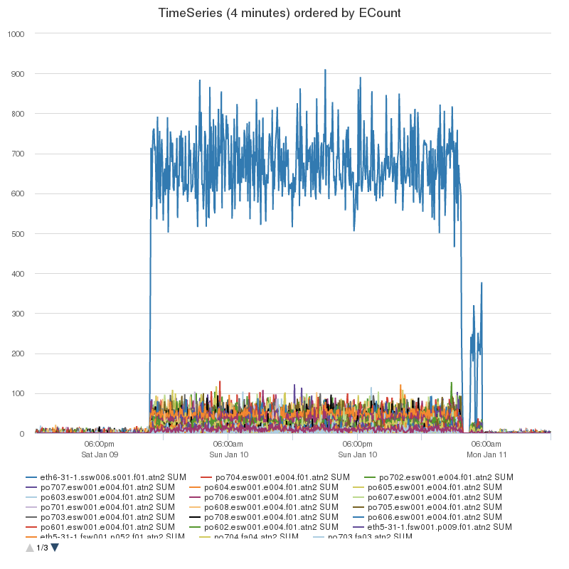
Fabric Grey Failure Detection

Slide 40
Conclusions
Fault isolation is actively evolving
Traceroute + probing approach is quite generic
Limited by current hardware
Backbone path churn is a serious challenge
Notes:
To sum up on fault isolation, this is still an area of active development. Lots of ideas being tried, most of them work for data-center, but tackling the backbone case if the hardest. If you have idea and want to help – you are more than welcome!

